Slide 1
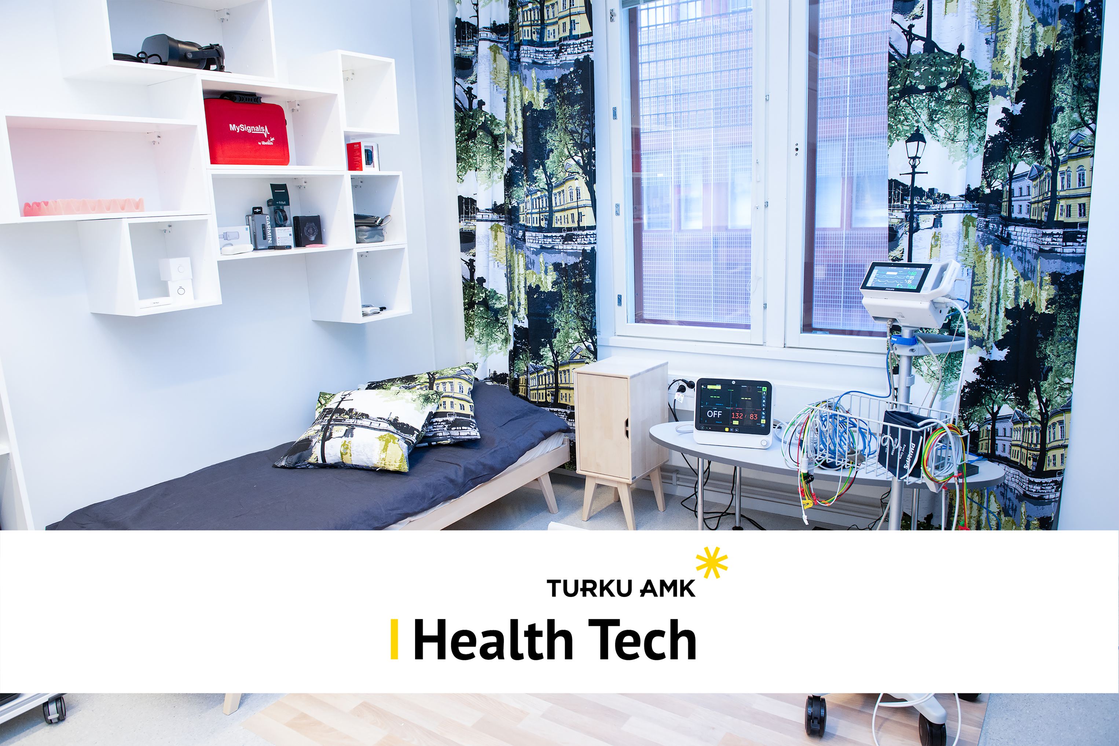
BIOSIGNALS AS A
GAME CONTROLLER

Slide 2

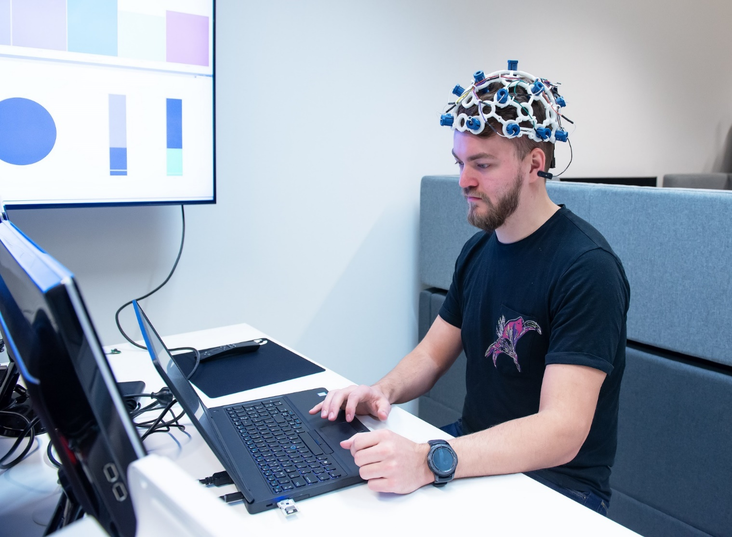
Project
Add new layers to gameplay by implementing players physiological measurements to the input scheme. Improve vehicle controls by adding grip strength from EMG or reduce tunnel vision by increasing field of view based on heartrate.

Slide 3
Background
Biosignals can be used as a human-machine interface in a variety of applications, including gaming, rehabilitation, and communication for individuals with disabilities.

Slide 4
Objectives
Use players physiological measurements as an input for games.
Adjust game settings based on player condition.

Slide 5
Skills needed in team
Project and communication skills
Programming skills
(Python/Matlab. Bonus for C/C++)
Data handling CSV and data streams
Familiar in working with APIs
Physiological measurements EKG/EMG/RSP etc.
Documentation skills

Slide 6

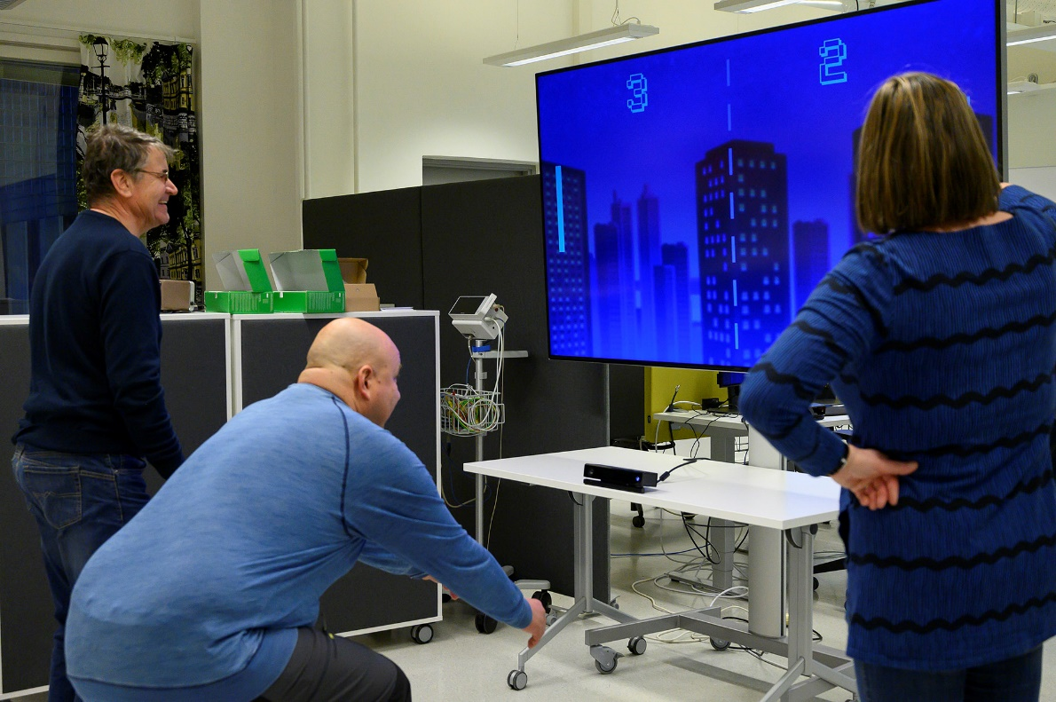
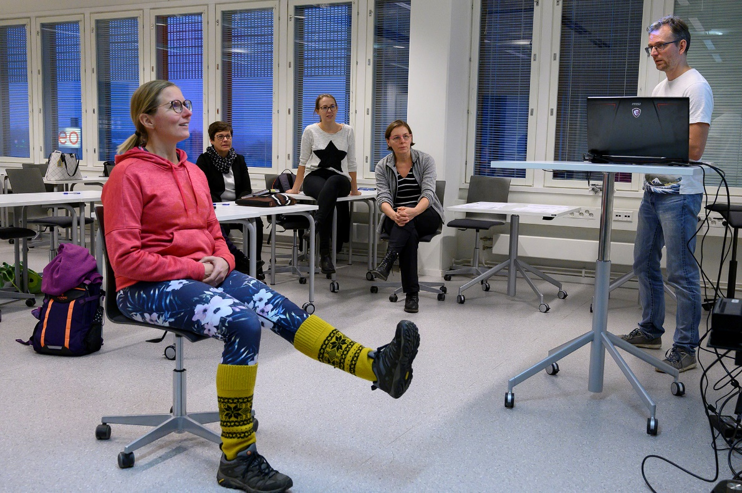
Enough of challenge?
For further information contact with email or visit us at the lab (ICT B3049)
juho.koskinen@turkuamk.fi, juho.p.metsavuori@turkuamk.fi

